Slide 1

Green Group
Wednesday 13th January 2021
LI – To retrieve information from a non-fiction (factual) text.

Slide 2

Think about:
What is ‘New Year’ and why is it special?
Do you know of any New Year traditions?
What is a New Year’s resolution?

Slide 3

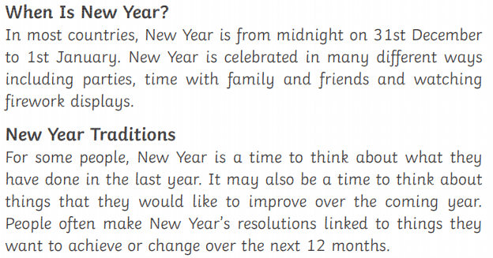

Slide 4
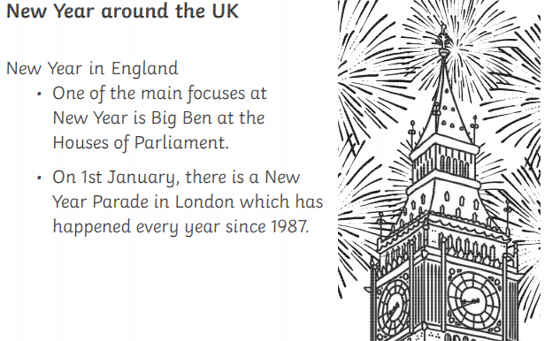

Slide 5
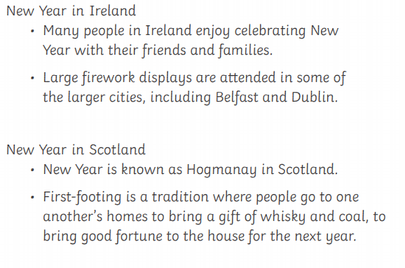

Slide 6
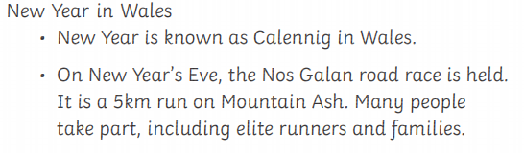

Slide 7
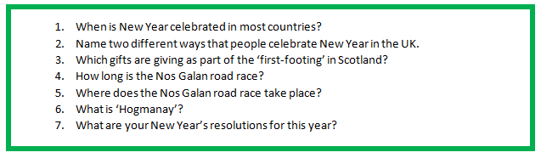
Question Time
Remember to answer all questions in full sentences – you can use the question to help form your answer.
.
Talk through your answers before you write them down to check that your answers makes sense!

Slide 8
When is New Year celebrated in most countries?
__________________________________________________________________________________________________________________________________________________________________________________

