Slide 1

Blue Group
Wednesday 13th January 2021
LI – To retrieve information from a non-fiction (factual) text.

Slide 2

Think about:
What is ‘New Year’ and why is it special?
What do you do for New Year?
What is a New Year’s resolution?

Slide 3

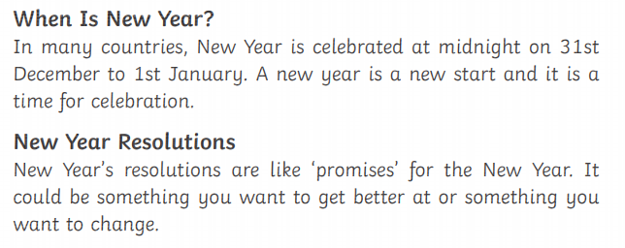

Slide 4
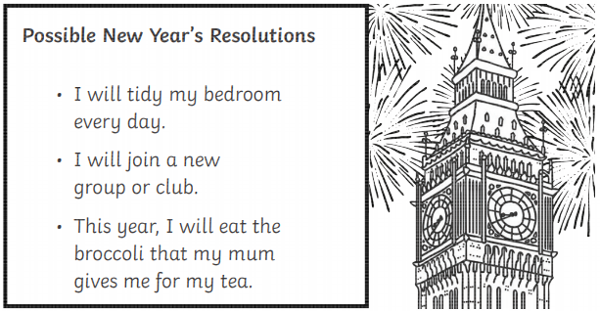

Slide 5
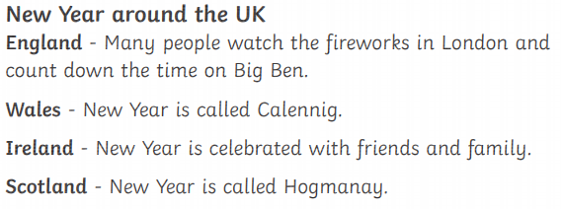

Slide 6
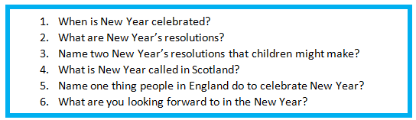
Question Time
Remember to answer all questions in full sentences.
.
Talk through your answer before you write it down and check that your answer makes sense!

Slide 7
When is New Year celebrated?
__________________________________________________________________________________________________________________________________________________________________________________

